Slide 1
Mission 12 Remix
Create your own project from Mission 12

Slide 2
Warm-up
Mission 12 introduced the light sensor
What are some digital devices that might have a light sensor in it?

Slide 3
Time for a project remix!
A remix can be:
A new program created by adding new code to a program you already created
You can combine parts of two or more programs in a remix
Use a similar idea in a different way

Slide 4
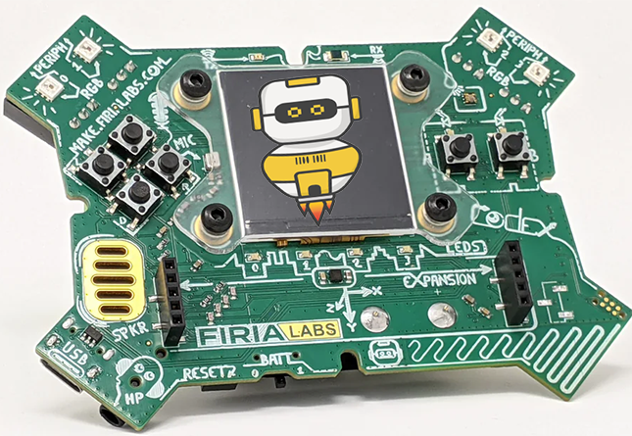
Project Remix
Creating a remix will let you:
Improve your skills and practice the concepts from the mission
Be creative
Remember code from earlier programs and missions
Work with other students
Design an original program and write the code all on your own

Slide 5
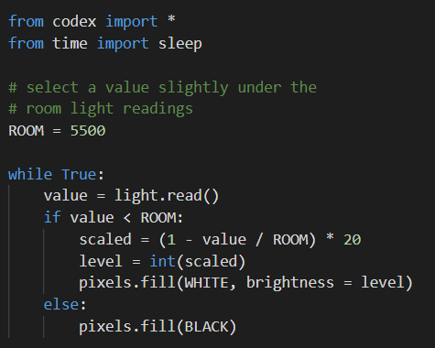
Step #1
Review the mission
Open your project from Mission 12
What does the program do?
What skills were used or concepts learned?
DO THIS:
Fill out the information in the Mission 12 Remix Log for Step 1

Slide 6
Step #2
Brainstorm ideas
Read through remix suggestions from your teacher
Four suggestions are on the next 2 slides. You can use any of these ideas or come up with your own.

Slide 7
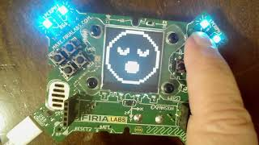
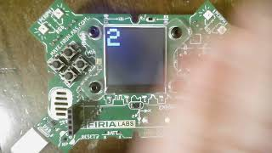
Step #2 Remix Ideas
Mild-1
Add another level variable of light intensity to the program -- it could be for bright light or very dark. This will give CodeX three options for the light sensor reading.
Medium-2A
Change CodeX to a people counter. When the light sensor changes from room light to dark, increment a counter. Wait a little before checking again, so the person isn’t counted twice.

Slide 8
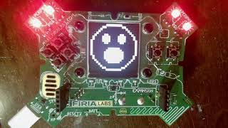
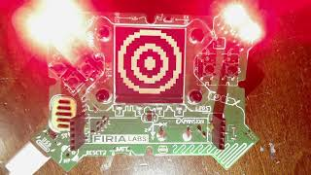
Step #2 Remix Ideas
Medium-2B
Change CodeX to an alarm. When room light is detected instead of dark, an alarm will sound. Otherwise, display a peaceful picture.
Spicy-3
Add more level variables for CodeX, with each variation of light intensity displaying a different picture and pixel color. Try five levels.

Slide 9
Step #2
Brainstorm ideas
Read through remix suggestions from your teacher (previous slides)
Use the suggestions as presented, or combine some of the options for your own mild, medium, or spicy project
Use your creativity to come up with your own idea for a project
Decide with your partner what project you will do
DO THIS:
Fill out the information in the Mission 12 Remix Log for Step #2

Slide 10
Step #3
Make a plan
What variables or constants will you need? What values will they hold, or what will you use them for?
What if statements will you need for the program?
What buttons will you program, and what will each button do?
DO THIS:
Fill out the information in the Mission 12 Remix Log for Step #3

Slide 11
Step #4
Code your project
IMPORTANT: In CodeSpace, go to the sandbox
Start with a new file and give it a descriptive name (Remix12)
You can leave any program open, including NightLight, and use it as a guide
Import your modules
Create variables and constants as you go or when you see a need
Write your code, testing frequently

Slide 12
Step #4
Stop and test frequently!
Don’t try to write all the code at one time
Think about the steps:
Just get one thing to work, then move on
Step by step!
Mistakes happen, so find them early
Type just a few lines of code and then run the program
If there is an error, fix it before continuing
Use the debugger and your other programs for help

Slide 13
Step #5
Documentation!
Make sure your code is readable by adding blank lines
Add comments to sections of your code that explain what they do

Slide 14
Step #5
Get feedback
Show your code to other students.
What do they think? Have them fill out the feedback form on your Mission 12 Remix Log.
The Mission Log has space for two people to give feedback. The feedback can come from two peers or one peer and yourself.
Modify your code to make your project even better

Slide 15
And now you have your own remix!
Congratulations!
By completing this remix you have:
learned more about programming
practiced the skills and concepts from the missions
been thinking! And problem solving and much more!

Slide 16
Mission Reflection
Wow! Great job!
Share your project with your friends!
Run projects from other students
Complete your Mission 12 Remix Log
Don’t forget to clear your CodeX by running your Clear program

